Slide 1
“I hope this plan finds itself in the dustbin of history.”
David Kroyanker, architect, urban planner and architectural historian of Jerusalem

Slide 2
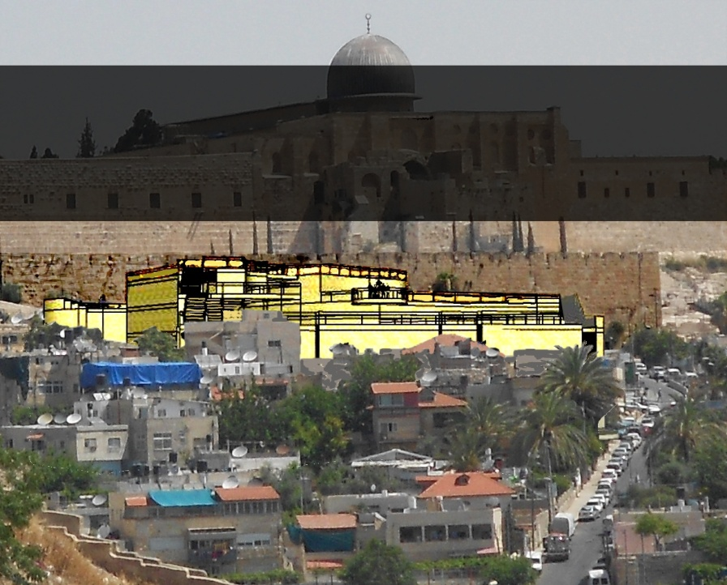
Have you heard of the
Kedem Compound?

Slide 3
The "Kedem Compound", potentially the most ostentatious structure built in the area of the Old City in a hundred years, is slated to be built opposite the Temple Mount/Haram al-Sharif, steps away from the Old City walls, in the heart of the Palestinian neighborhood of Silwan.

Slide 4
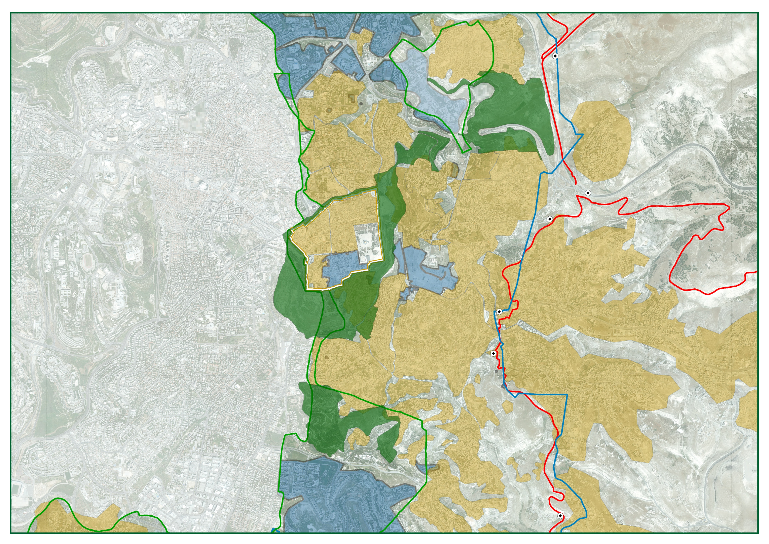
The structure will be erected a mere 20 meters from the Old City walls, in violation of planning principles that have been maintained in Jerusalem since the British Mandate Period and which were incorporated in the Jerusalem Master Plan. These principles forbid new construction within a distance of 75 meters from the Old City walls.

Slide 5
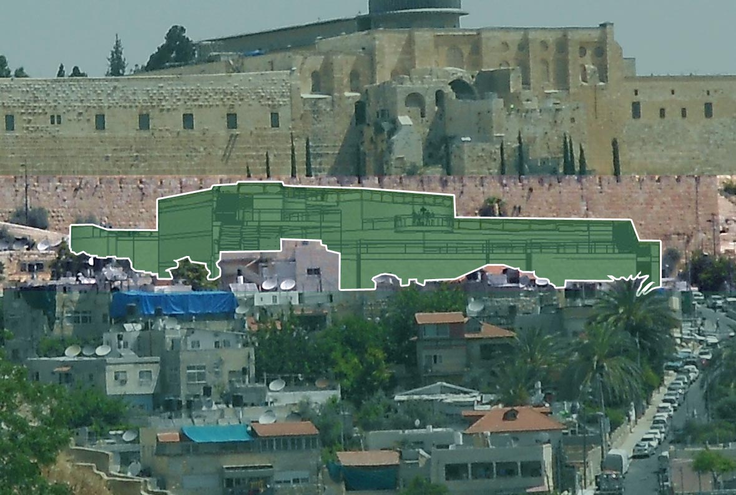
Height of the Wall
Kedem Compound
If constructed, the Kedem Compound will reach just 4 meters below the height of the Old City walls. And it will be built with complete disregard for planning principles prohibiting new building that obstructs specified views of conservation areas, including the Old City walls. In an effort to blur this reality, the plan was presented to the District Planning and Building Committee using a visual image created from an aerial view.

Slide 6
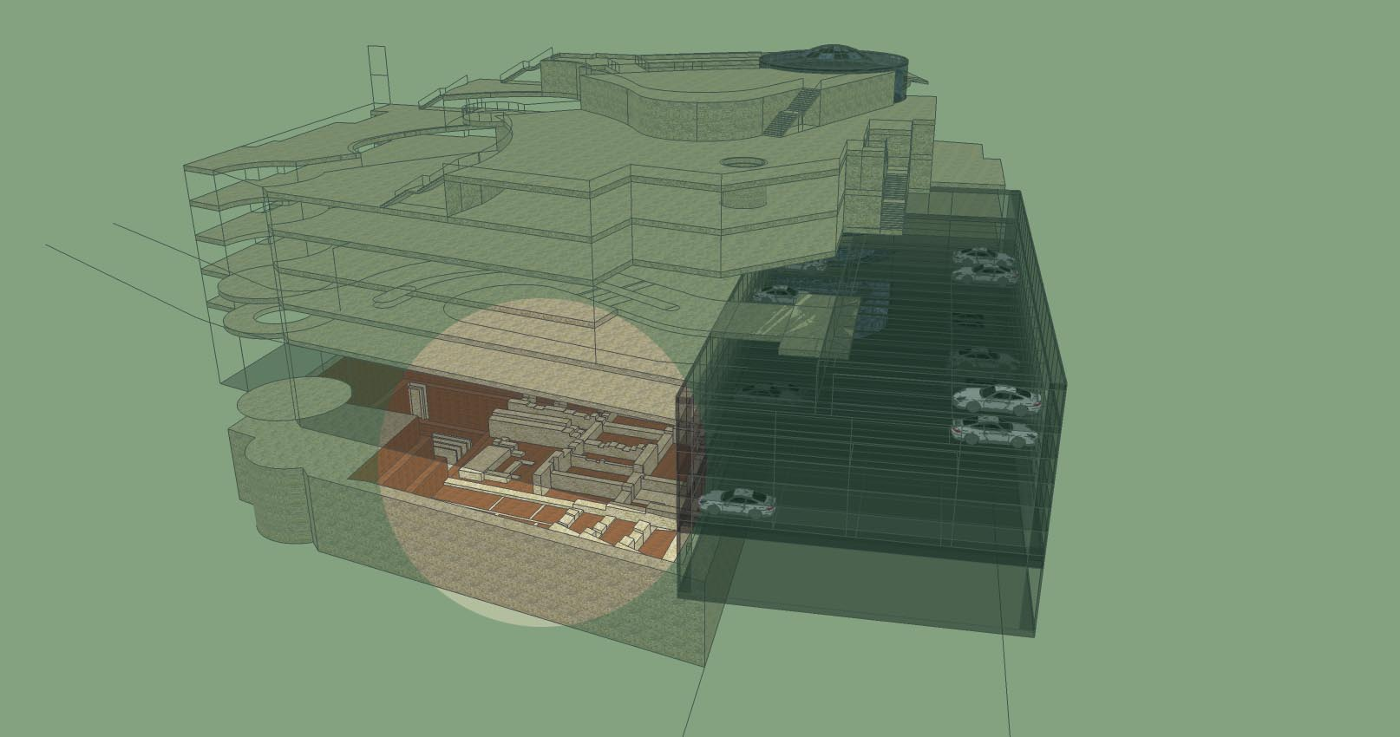
The structure will be built on top of an important archeological site. Known archeological artifacts will be "presented to the community" from the basement level, underneath an underground parking lot. Other artifacts yet to be unearthed will simply be buried beneath the structure.

Slide 7
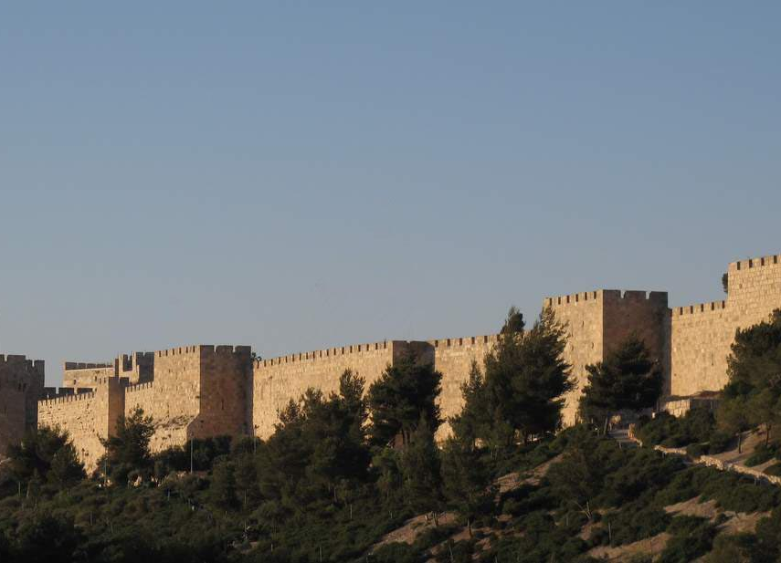

The Old City walls of Jerusalem are recognized by UNESCO as an Endangered World Heritage Site and therefore entitled to protection. However, the head of UNESCO Israel, the body entrusted with the protection of the Old City walls, is none other than the architect of the plan for the Kedem Compound, Arieh Rahamimov.

Slide 8

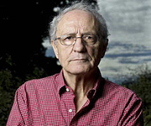
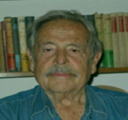

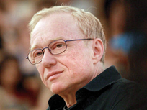
Alona Nitzan Shiftan
Ze'ev Sternhell
Haim Gouri
Agi Mishol
David Grossman
35 urban planners, Israel Prize winners and cultural figures have signed on to a public objection against the plan. According to these 35 figures, "the plan threatens to create a massive multi-story structure at an irresponsible distance from the Old City walls and foreign to its surroundings…the proposed plan would transform the traditional character of the churches of the Old City and lead to the burial of archaeological artifacts.”

Slide 9
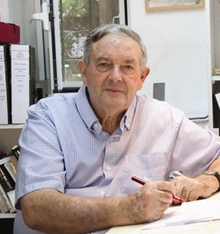
One of the signatories to the public objection is the architect David Kroyanker, winner of the Yakir Yerushalayim Award (Worthy Citizen of Jerusalem) and author of tens of books on the architectural history of Jerusalem. He is also a winner of a Teddy Kollek Lifetime Achievement award for the preservation of historic sites in the city and a previous director of the preservation staff for the Jerusalem 2000 Master Plan. Here is what he has to say:
Notes:
ה

Slide 10
"I have been studying Jerusalem urban planning for almost 45 years and never have I encountered such an audacious plan with such destructive potential…there is a question of precedent here. This is an injury to the principles of national park planning, and for that reason, it is an insult…I hope that this plan finds itself in the dustbin of history.“

Slide 11

The Jerusalem Municipality generally prides itself on its projects. So in this particular case, why has it remained silent?

Slide 12
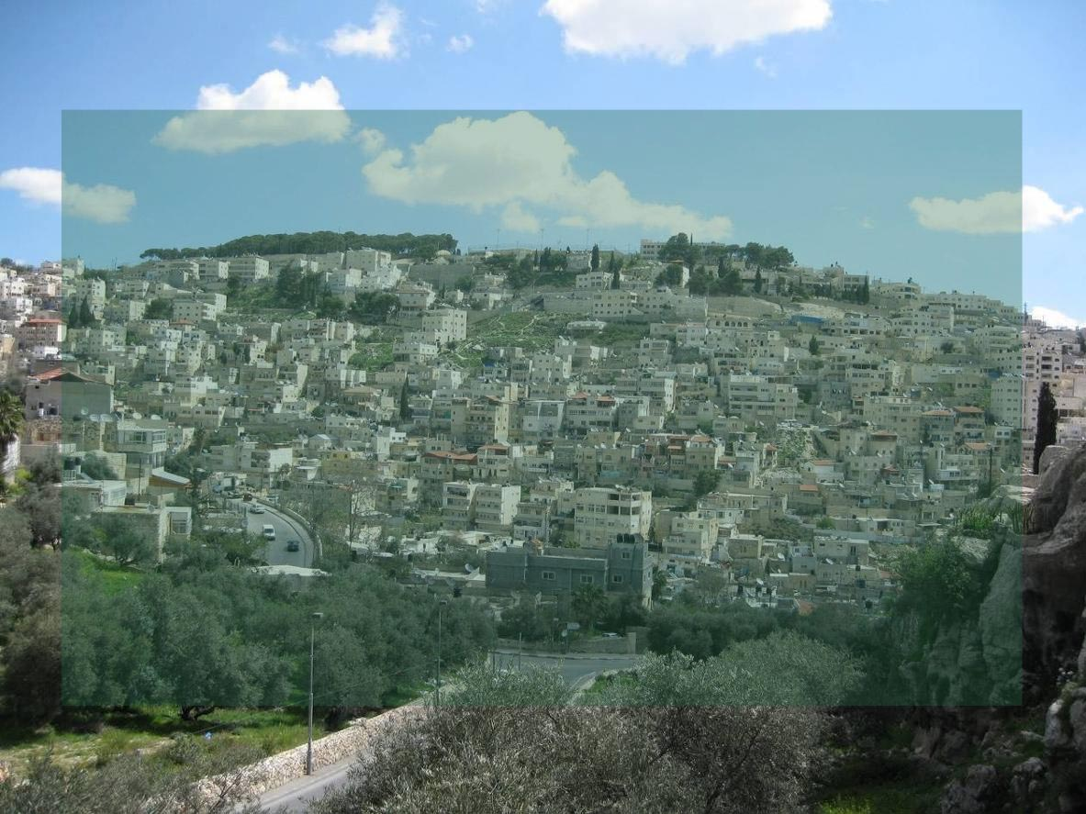
Most likely, because the right-wing organization ELAD—whose goal is to impose a singular national Jewish narrative onto Palestinian Silwan—is behind the project. It is also difficult to ignore the timing: ELAD is advancing the plan against a backdrop of ongoing attempts to sabotage the peace process. It appears that the pursuit of these goals is reason enough to sacrifice the planning principles of the Old City as well as proper administrative rules for the planning process. And all of this hidden from the public eye.

Slide 13
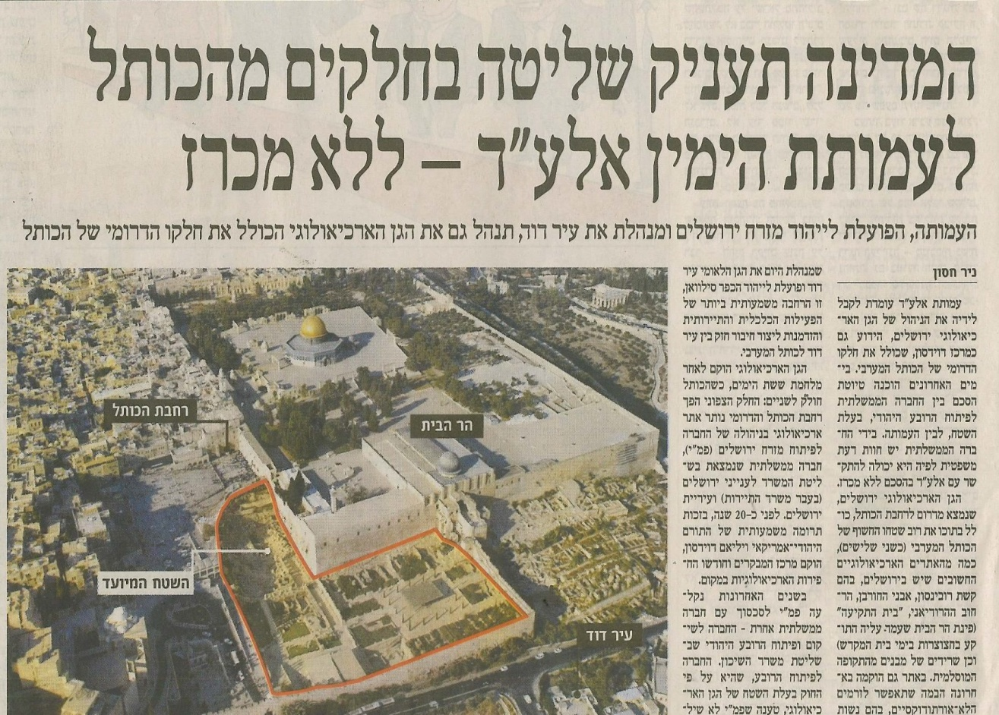
The Kedem Compound is one more link in a chain of properties and compounds the State has privatized and passed into the hands of ELAD, including the City of David National Park. Today, a contract to award ELAD management of the Davidson Center archaeological park adjacent to the Western Wall Plaza is currently in the advanced stages of negotiation.

Slide 14

We have more than enough controversial projects in Jerusalem brokered in the dark, without public discussion and left to the responsibility of future generations. This architectural outrage cannot go unchallenged.

Slide 15
These public figures have already signed on to the public objection. Will you ?
Almog Behar
Professor Moshe Halbertal
Professor Ze'ev Sternhell
Architect David Kroyanker
Agi Mishol
David Grossman
Professor Alona Nitzan-Shiftan
Roy Hasan
Professor Zali Gurevitch
Dr. Meron Benvenisti
Professor
Elisha Efrat
Larry Abramson
Professor Elhanan Reiner
Dr. Haim Yacobi
Haim Gouri
Ilan Baruch
Professor
Yoram Bilu
Professor Yaron Ezrahi
Professor
Ayala Ronel
Professor
Moshe Margalit
Architect
Shmuel Groag
Professor
Alice Shalvi
Professor
Yossi Ben-Artzi
Architect Omri Eytan
Professor
Ronnie Ellenblum
Dr. Gideon Efrat
Architect Yuval Yasky
Professor Tzibi Geva
Benjamin Shvili
Architect
Dov Alon
Dr. Gilad Meiri
Professor David Guggenheim
Professor Menachem Brinker

Slide 16
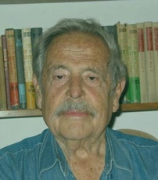
"Jerusalem is the three religions and two nations that cling to it; it is such a wondrous city and something like this just cannot be done by the insolence of one side.
I am deeply concerned about this [Kedem Compound].”
Haim Gouri, poet, author, lyricist; winner of the Bialik Prize, Israel Prize and Sokolov Prize

Slide 17

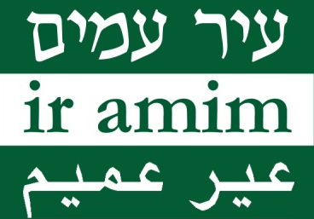
Hands Off the Walls !
You can help us halt the Kedem Project by spreading the word. Please circulate this presentation.
Provided as a public service

